Slide 1

ARUN A
B.Tech AI & DS
SINCET
Naan Mudhalvan Project

Slide 2
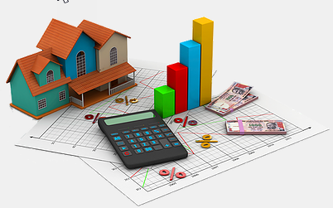
Predicting House price using CNN

Slide 3

AGENDA
Overview of the importance of house price prediction in real estate markets.
Introduction to the conventional methods of house price prediction.
Brief explanation of the application of CNNs in the field of predictive modeling.
3/21/2024 Annual Review

Slide 4

PROBLEM STATEMENT
Develop a CNN model to accurately predict house prices based on various features and image data.
Utilize a dataset containing both numerical attributes and images of houses to train the CNN for regression-based prediction tasks.
Optimize the CNN architecture and training process to achieve high performance in estimating house prices.

Slide 5

PROJECT OVERVIEW
Project Objective: The project aims to develop a CNN model to predict house prices based on input images of residential properties.
Methodology: The project involves collecting a dataset of labeled images of houses along with their respective prices.
Expected Outcome: Upon completion, the project anticipates delivering a robust CNN model capable of accurately predicting house prices based solely on input images.

Slide 6

WHO ARE THE END USERS?
Real Estate Agents
Home Buyers and Sellers
Property Investors
Financial Institutions
Government Agencies
Research Institutions
Software Developers
General Public

Slide 7
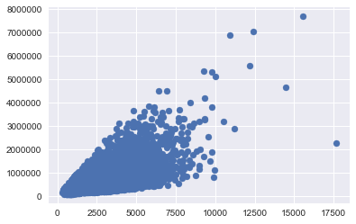
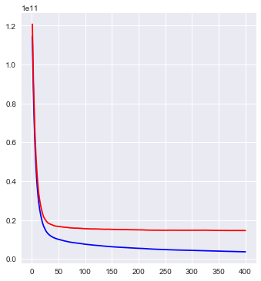
SOLUTION AND ITS VALUE PROPOSITION
Price vs Square Feet
Value and Worthiness

Slide 8
THE WOW IN YOUR SOLUTION
Revolutionizing Real Estate: House Price Forecasting with Cutting-Edge CNN Technology.
Breaking Ground: CNN-Powered House Price Prediction for Future Real Estate Trends
.
Unlocking the Future: CNN Driven Predictive Modeling for House Prices.
Next-Gen Real Estate: Forecasting House Prices Using CNN Innovation.
‹#›

Slide 9
MODELLING
Data Collection and Preprocessing:Collect a dataset containing images of houses along with their corresponding prices.
Data Augmentation:Perform data augmentation techniques such as rotation, flipping, and scaling to increase the diversity of the dataset and improve model generalization.
Model Architecture:Design a CNN architecture suitable for image regression tasks. You can start with a simple architecture consisting of convolutional layers followed by pooling layers, flattening layer, and dense layers.
‹#›

Slide 10

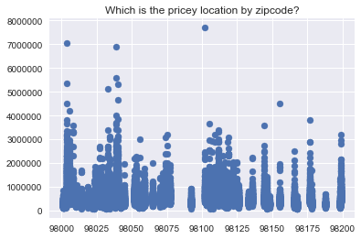
RESULTS
Which is the price location by zip code
‹#›

